Slide 1

FRONT END DEVELOPEMENT
SURVEY PORTAL
SUMMER TRAINING PROJECT
POWERGRID CORPORATION
OF INDIA LIMITED
ANMOL JAIN 00629802017

Slide 2
OBJECTIVE
Objective of this Online Survey is to help both Surveyor and Respondent in terms of both time and effort. Power Grid Corporation of India Limited provides an special portal for all of its employees which has a constantly updated notice panel, link to the survey portal will be displayed in notice panel of all the employees which needs to fill the survey in the Internet Portal, making it easier to access for employees as this portal is something which they access several times daily.
This online survey also makes it easier for surveyor to keep the track of all the responses, and to reduces the time to conduct the whole survey greatly while still maintaining the anonymity of the respondent.

Slide 3
METHODOLOGY
UI/UX Design
HTML
CSS
jQuery (JavaScript)

Slide 4

t
PRINCIPLES OF
UI/UX
USER INTERFACE
Structure
Simplicity
Visibility
Feedbackt
USER EXPERIENCE
Hierarchy
Consistency
User Control
Accessbility

Slide 5
BASIC STRUCTURE
HTML
Basic HTML
[Tags, Elements, Attributes, Lists, Color Codes]
HTML Forms
[Inputs, Text Field, Checkbox, Radio Button, Buttons]

Slide 6
STYLING
CSS
Basic CSS
[Selectors, Styling, Background, ID, Font Family, Padding, Margin, Hover]
Advance CSS
[Border Radius, Opacity, Cursor, Layers, Position, Display]
Template, design using CSS div tags.

Slide 7
FUNCTIONALITY
JQUERY (JAVASCRIPT)
Basic jQuery
[Syntax, Operators, Variables, Events, Alerts]
Advance jQuery
[DOM Manipulation, addClass, removeClass]

Slide 8
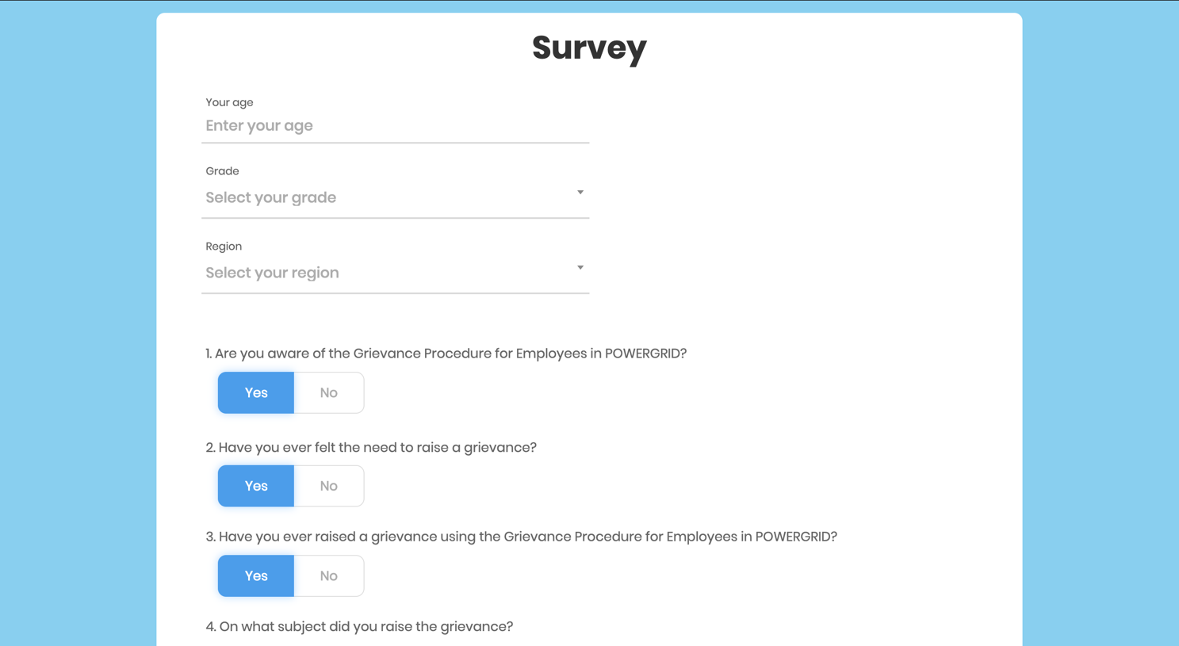
SCREENSHOTS

Slide 9
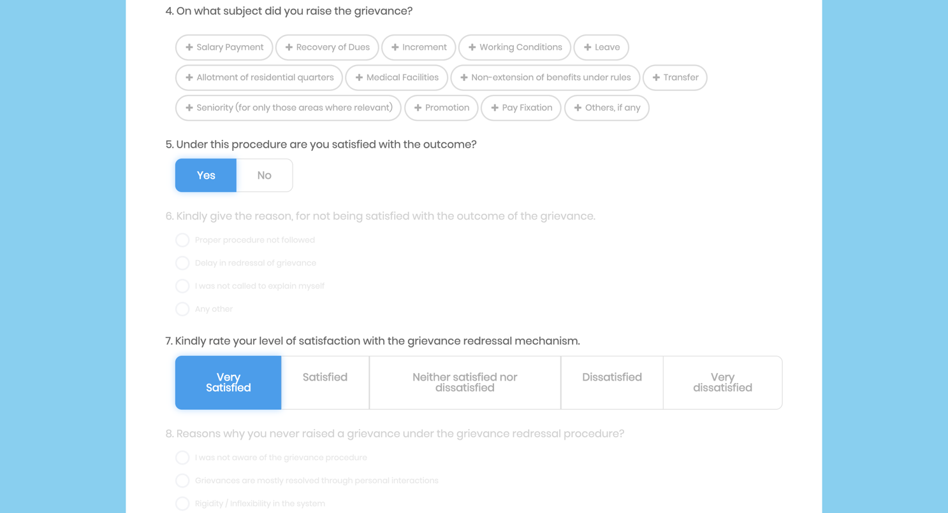
SCREENSHOTS

Slide 10
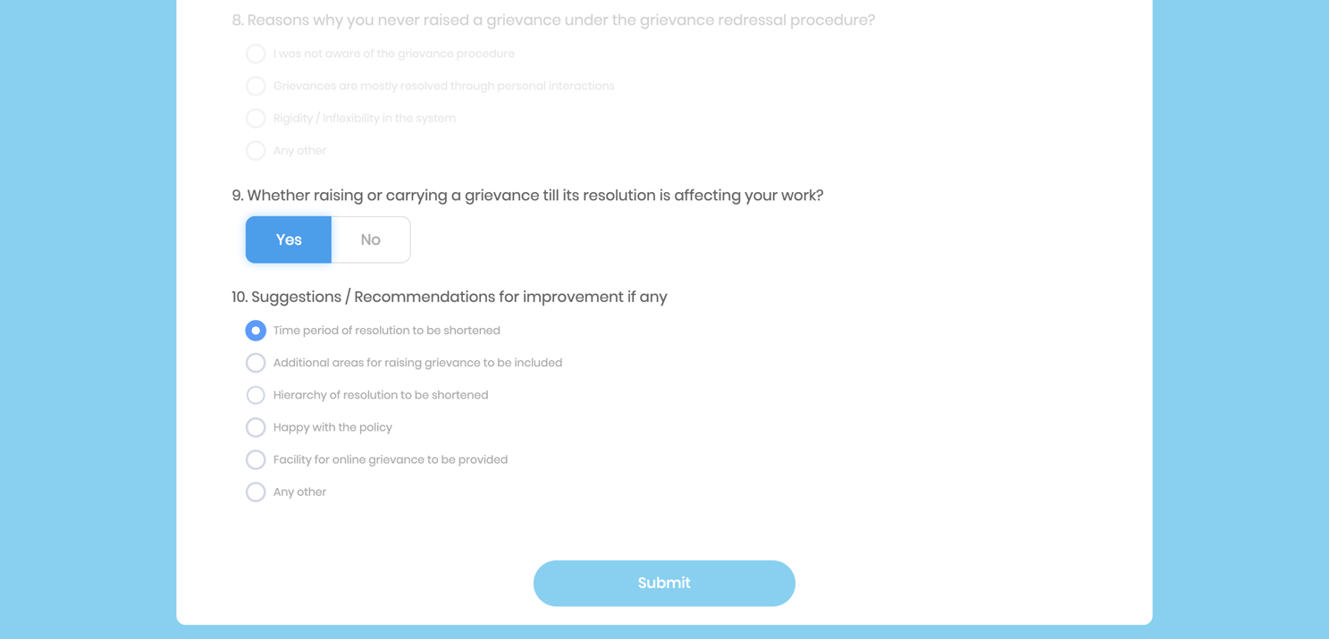
SCREENSHOTS

Slide 11
CONCLUSION
As a conclusion, I can say that this internship was a great experience. Thanks to this project, I acquired deeper knowledge concerning my technical skills of HTML, CSS and also rather than using Javascript which I already knew I learnt something new, i.e., jQuery.
It is available in two versions, one plain HTML/CSs version and another embedded in ASP.NET Core Framework.
Project Source Code is also available at:
https://github.com/DefinitelyNotAnmol/Power-Grid

